Slide 1
University Management system
Faculty of engineering
CSC301 Lab final project
Presented by: Dominic Eid – Section C (202201394)
Instructor: Dr. Wajdi Abboud

Slide 2
Table of contents:
Project objective
Difficulties and possible improvements
Methods used in the project
Header files
In-depth list
Explanation of some functions

Slide 3
Project Objectives
The main purpose of this management system is to register students and teachers in a university’s engineering faculty in addition to managing their schedules and courses.
This application allows the higher ups of the university to input and display the information of students and teachers while being able to add, remove and update said information. It also allows the user to sort and group the members of the university by age, semester started, majors and age and proceeds to save all the registered information into modifiable and protected binary files.
This program also allows the user to set and manage the schedule of students and teachers by managing the courses taken/taught (course period, number of credits, date) and saving the information into a printable text file saved into the project directory. Note: Each student/teacher gets their own schedule text file.

Slide 4
Difficulties and possible improvements
Difficulties:
Working with binary files proved to be challenging
Working with multiple header files
Working with multiple classes that include inherited classes
Possible improvements:
Adding a graphical user interface
Using SQL to store all the data in a database
Adding more course management options

Slide 5
Methods used in the project
Iterative functions (input, output, sorting, swapping,…)
Recursive functions (search functions)
Pointers
Pointers to pointers
Structures (struct semester)
Classes (students, teachers, date, time,…)
Objects (schedule object)
Array of objects (array of students, array of teachers)
Friend functions
Inheritance
Operator overloading (ostream, istream and += operators)
Binary files (students file, teachers file, major files)
Text files (schedule files)

Slide 6
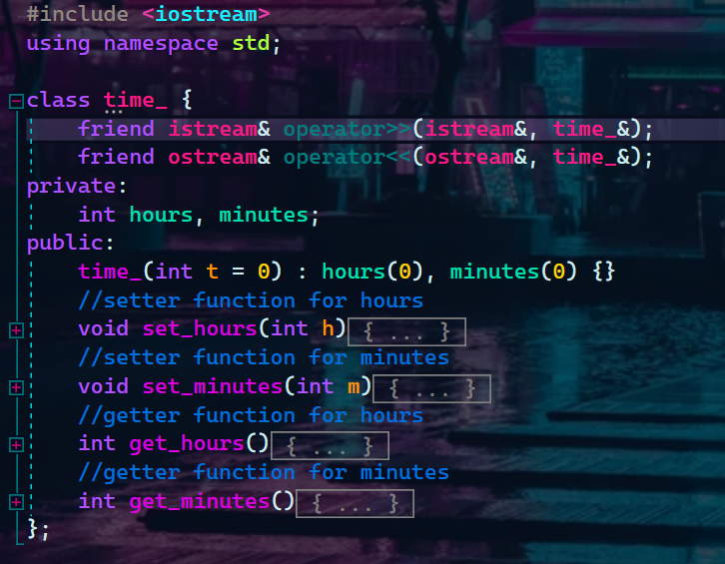
Header file – Time_.H
Contains time_ class
Class contains overloaded operators << and >>
Class contains 2 integers: hours and minutes
Used in course class to set a course’s time period

Slide 7
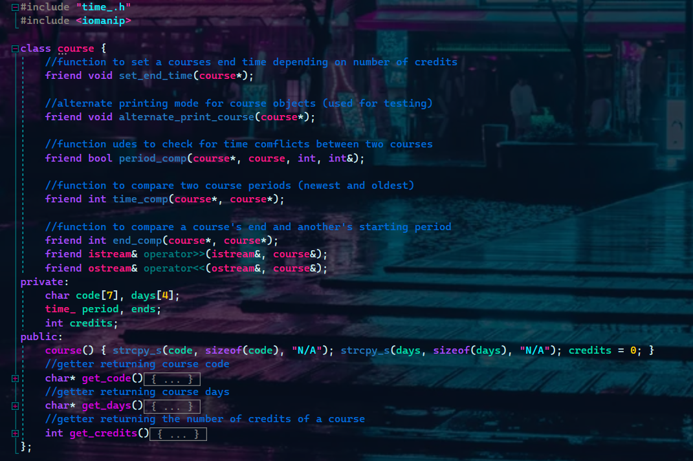
Header file – Course.h
Contains course class
Includes time_.h header file
Overloaded operator >> to set the course’s code, the days the course takes place in, the beginning and end of a course (time_ objects) and the number of credits of a course
Used in schedule class to set the courses taken/taught by students/teachers

Slide 8
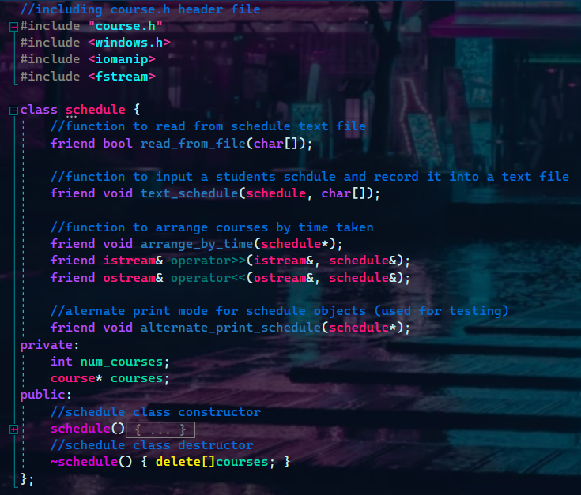
Header file – Schedule.h
Contains schedule class
Includes course.h header file
Creating an object of type schedule allows the user to enter the number of courses taken/taught by a student/teacher, then creates an array of objects of type course allowing the user to register students and teachers into these courses

Slide 9
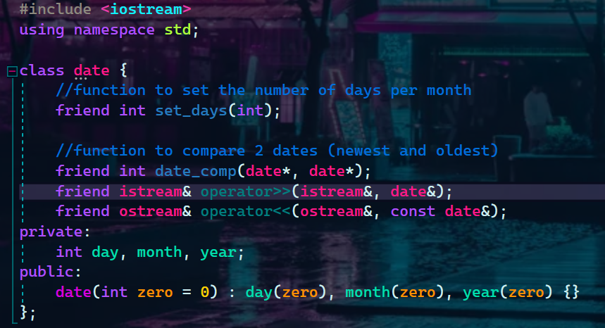
Header file – date.h
Contains class date
Class contains overloaded operators << and >>
Class contains 3 integers: day, month, year
Used in later classes to set a student/teacher’s date of birth

Slide 10
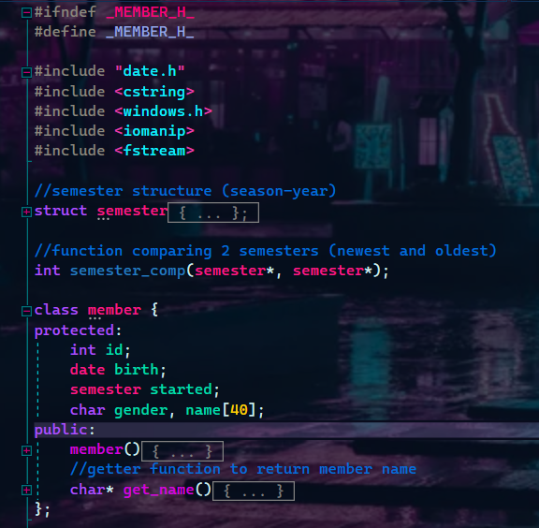
Header file – member.h
Contains member class
Contains semester structure
Includes date.h header file
Class contains common ground between teachers and students (id, date of birth, semester started, gender and name)
Used later in student and teacher classes as an inherited class

Slide 11
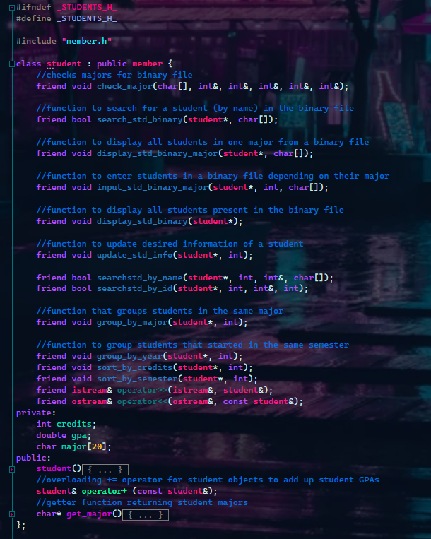
Header file – students.h
Contains student class derived from member class
Includes member.h header file
Overloaded operator >> to input student information such as id, name, gender, date of birth, semester started as well as number of credits completed, GPA and major
Overloaded operator += to sum up student GPAs and calculate the average in the binary file operation
Contains functions to sort students by semester started and number of credits completed
Contains functions to group students by major and semester started
Contains a recursive function to search for students
Contains functions that allow the user to add, remove and modify students
Contains functions to input the students in a binary file and in another according to their major and display or remove the saved info

Slide 12
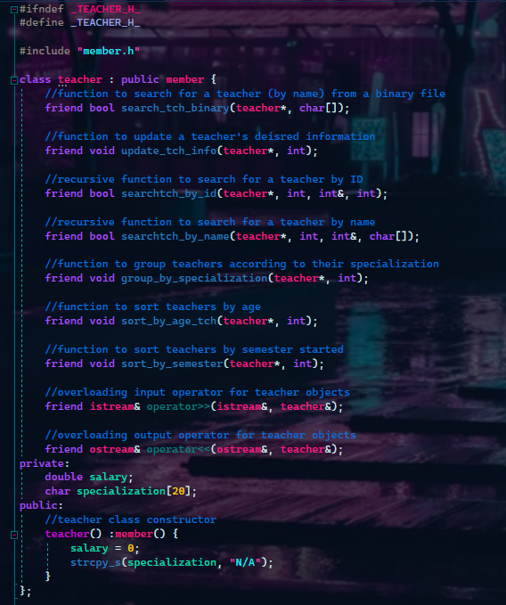
Header file – teachers.h
Contains teacher class derived from member class
Includes member.h header file
Overloaded operator >> to input teacher information such as id, name, gender, date of birth, semester started as well as the teacher’s salary and specialization
Contains functions to sort teacher by semester started and age
Contains functions to group teachers by specialization
Contains a recursive function to search for teachers
Contains functions that allow the user to add, remove and modify teachers
Contains functions to input the teachers in a binary file as well as display and remove saved info

Slide 13
Student
Input/output
Sorting by semester/credits
Teacher
Input/output
Sorting by semester/age
Schedule
Grouping by semester/major
Search by ID/name
Add/remove student
Update information
File options:
Students file (Binary)
Major files (Binary)
Grouping by specialization
Search by ID/name
Add/remove teacher
Update information
File options:
Teachers file (Binary)
Student schedule (Text file)
Teacher schedule (Text file)
Display schedules

Slide 14
Explanation of some difficult functions
“remove_std_binary” and “remove_tch_binary” functions:
These two functions open the original binary file and a new temporary binary file, then goes through the original in read mode and searches for the position of the desired student/teacher to remove.
The function then stores the position in an integer, then starts to write the info into the temporary file while using the seekg() function to skip over the position of the desired student/teacher.
The function then closes the files and removes the original files using the remove() function, and then proceeds to rename the new files as the older files using the rename() function.

Slide 15
“update_std_info” and “update_tch_info” functions:
These two function allow the user to search for the student/teacher by name or ID using the searchstd_by_id and searchstd_by_name or the searchtch_by_id and searchtch_by_name function by way of a switch operation.
The function then gives the user the options for updating also by way of a switch case.
The changes are applied to the array according to the position returned by the search functions
Overloaded operator+= function:
This function overloads the += operator for student objects.
It’s a member function of class student and it consists of adding up the student’s GPAs

Slide 16
“period_comp” function:
This function compares two courses by checking if they take place on the same days, then proceeds to check if the two courses start at the same time and checks if there’s a time conflict between the end time of the first course and the starting time of the second course.
The function returns true if there’s a conflict and returns false otherwise.
“semester_comp” function:
This function compares two semesters by first checking the year, then compares the seasons (fall, spring, summer) using strcmp().
The function returns 1 if the first semester is more recent, -1 if the second semester is more recent and 0 if both are the same semester.

Slide 17
“text_schedule” function:
This function creates a text file with the student/teacher’s name and write all the courses (time, days, code) into a calendar format
“read_from_file” function:
This function takes the name of the student/teacher and opens their specific schedule file.
The function proceeds to read line by line the text file containing the schedule and outputs it directly on the terminal.
“set_end_time” function:
This function takes the number of credits of a course and according to that number, sets the end time of each course: 3 hours for 1 credit courses and 1.5 hours for 2 and 3 credit courses.

Slide 18

That is all for this project
Thank you for your time and patience
Merry Christmas and happy new year! 🎄

